Slide 1

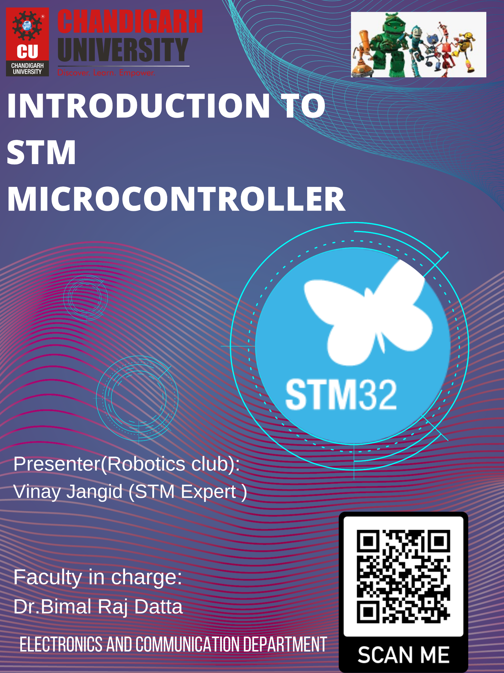

Slide 2

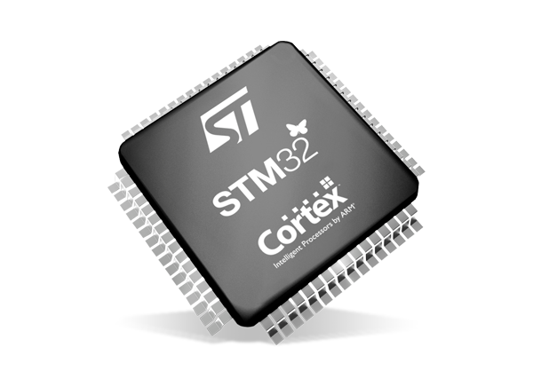
INTRODUCTION TO
STM MICROCONTROLLER
Presenters:
Princy Maurya
Vinay Jangid
Aman Kr. Singh

Slide 3
Introduction to STM
(Princy Maurya)

Slide 4
STMicroelectronics
A Swiss multinational semiconductor company.
Specializes in designing, manufacturing, and marketing a broad spectrum of semiconductor products.
Offers a wide range of packages and features.
Prominently known for the STM32 microcontroller family.
STM32 microcontrollers are 32-bit microcontrollers based on the ARM Cortex-M processor architecture.

Slide 5
STM32 Arm Cortex MPUs
Provides developers with greater design flexibility and performance
STM32 microprocessors are based on single or dual Arm® Cortex®-A cores, combined with a Cortex®-M core.
From cost-effective, single-core MPUs to more advanced, multicore MPUs, ST offers a scalable approach to help developers find the right fit.

Slide 6
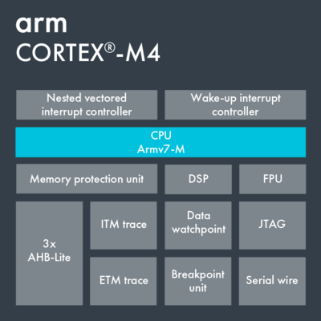
Arm® Cortex®-M4 Core
First core of the Cortex-M line up
Efficient
Easy-To-Use
Signal Processing Capabilities

Slide 7
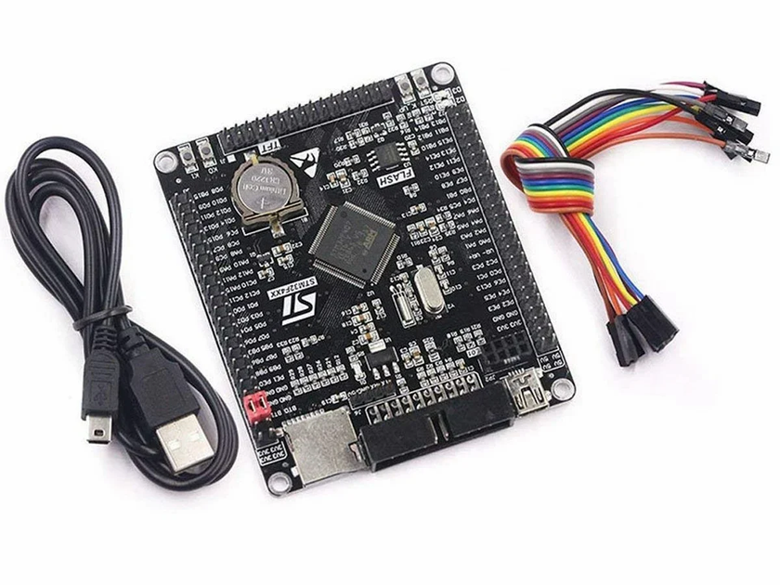
Key features of Arm® Cortex®-M4 core
Harvard bus architecture
3-stage pipeline
Wake-up interrupt controller
Optional 8 MPU regions with sub-regions and background region

Slide 8
Advantages of Arm® Cortex®-M4 MCUs
Single Instruction Multiple Data (SIMD) processing
Scalability and power efficiency
Digital Signal Processing
Non-Volatile embedded memory technology
High-performance architecture
Wireless connectivity expertise

Slide 9
J-Tag (Joint Test Action Group)
Commonly used debugging and programming interface.
Provides a standardized way to access and manipulate the internal components of a microcontroller.
Essential for tasks like debugging, firmware programming, and boundary scanning.
To use JTAG with an STM32 microcontroller, you need a JTAG programmer/debugger, such as a J-Link or ST-Link.

Slide 10
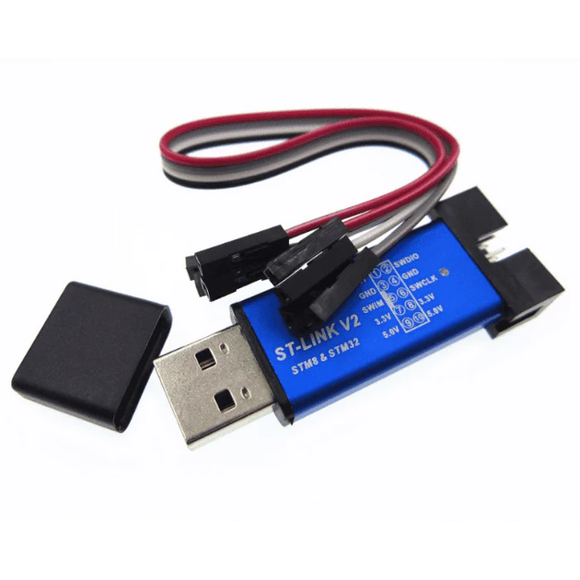
ST-Link
Commonly used debugger and programmer tool for STM32 microcontrollers.
Essential component in the STM32 development ecosystem.
Allows developers to program firmware, debug code, and inspect the internal state of STM32 microcontrollers.

Slide 11
Software Simulation
(Vinay Jangid)

Slide 12
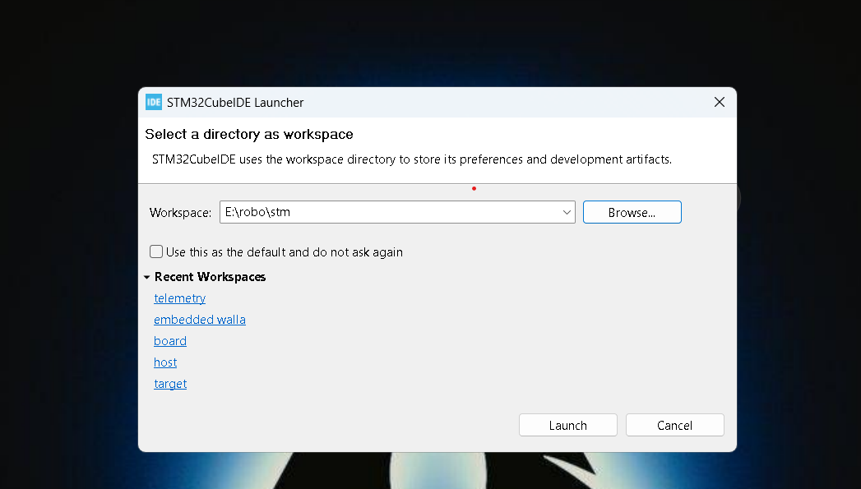
Step:- 1

Slide 13
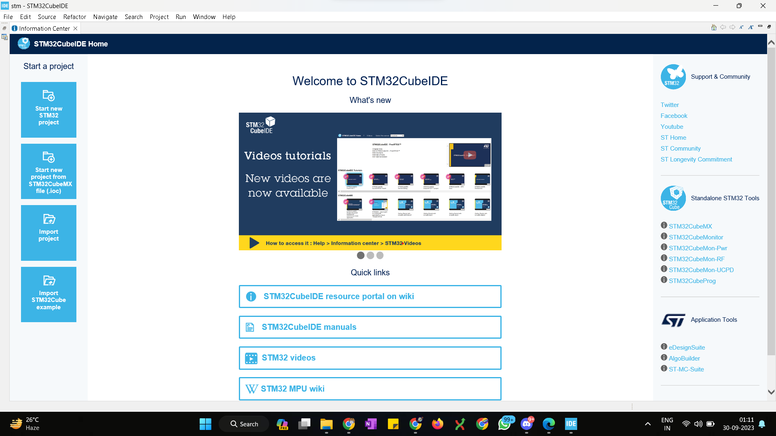
Step:- 2

Slide 14
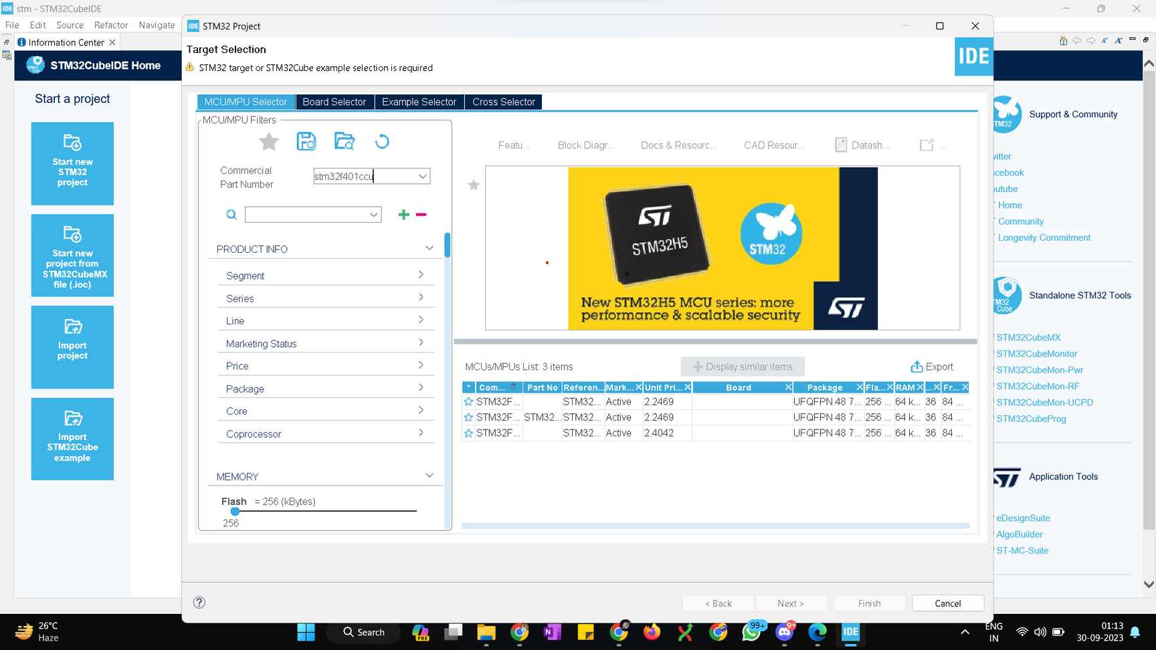
Step:- 3

Slide 15
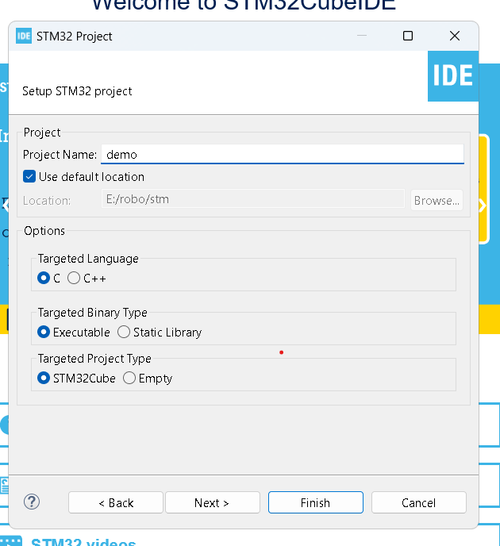
Step:- 4

Slide 16
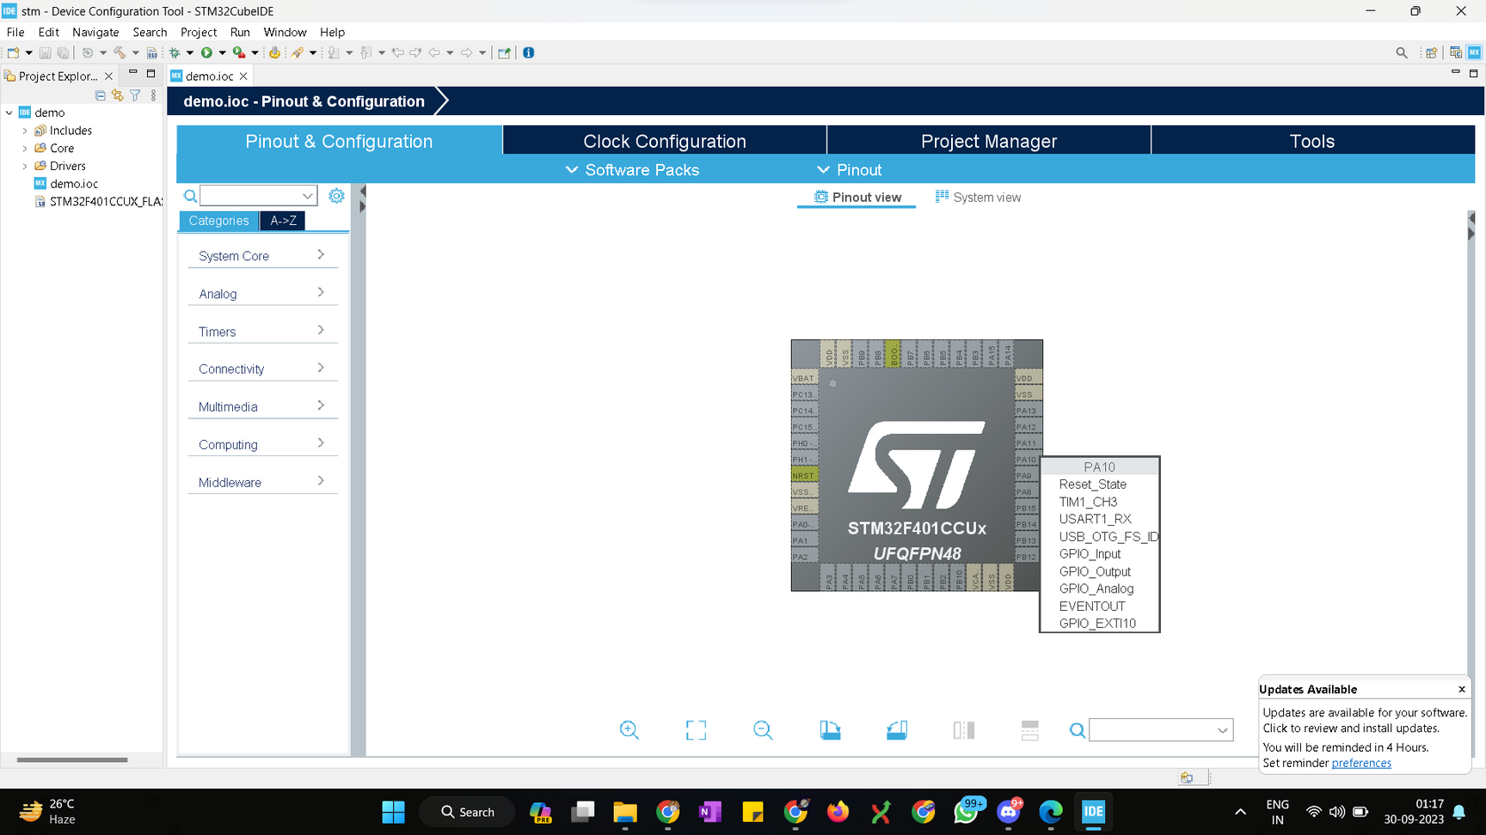
Step:- 5

Slide 17
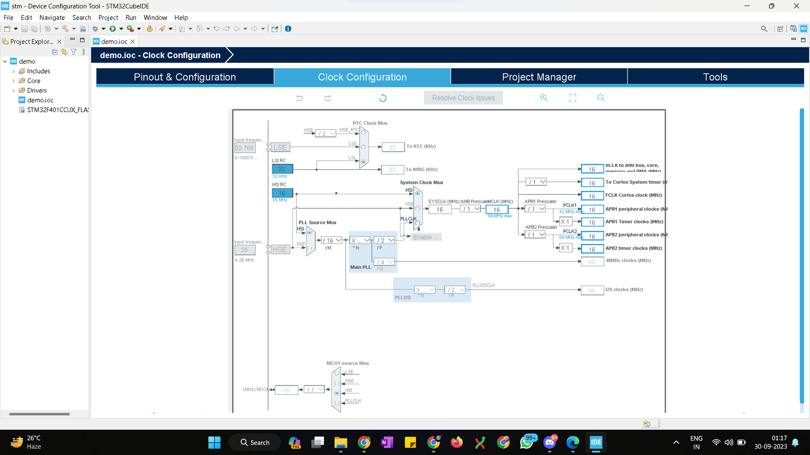
Step:- 6

Slide 18
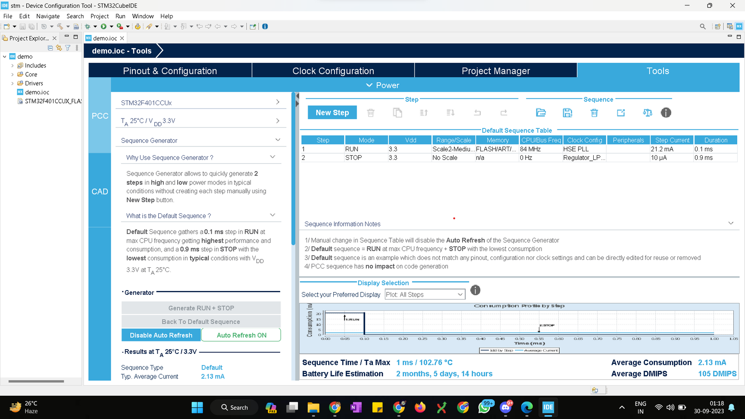
Step:- 7

Slide 19
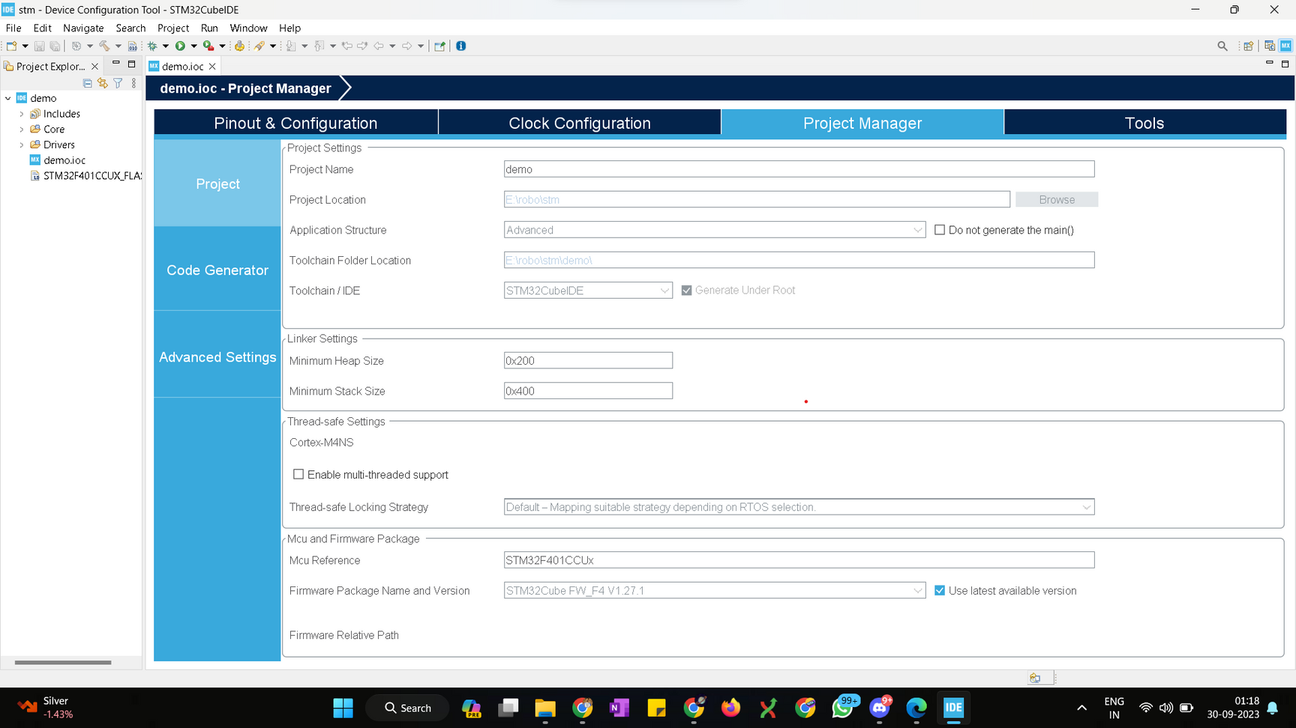
Step:- 8

Slide 20
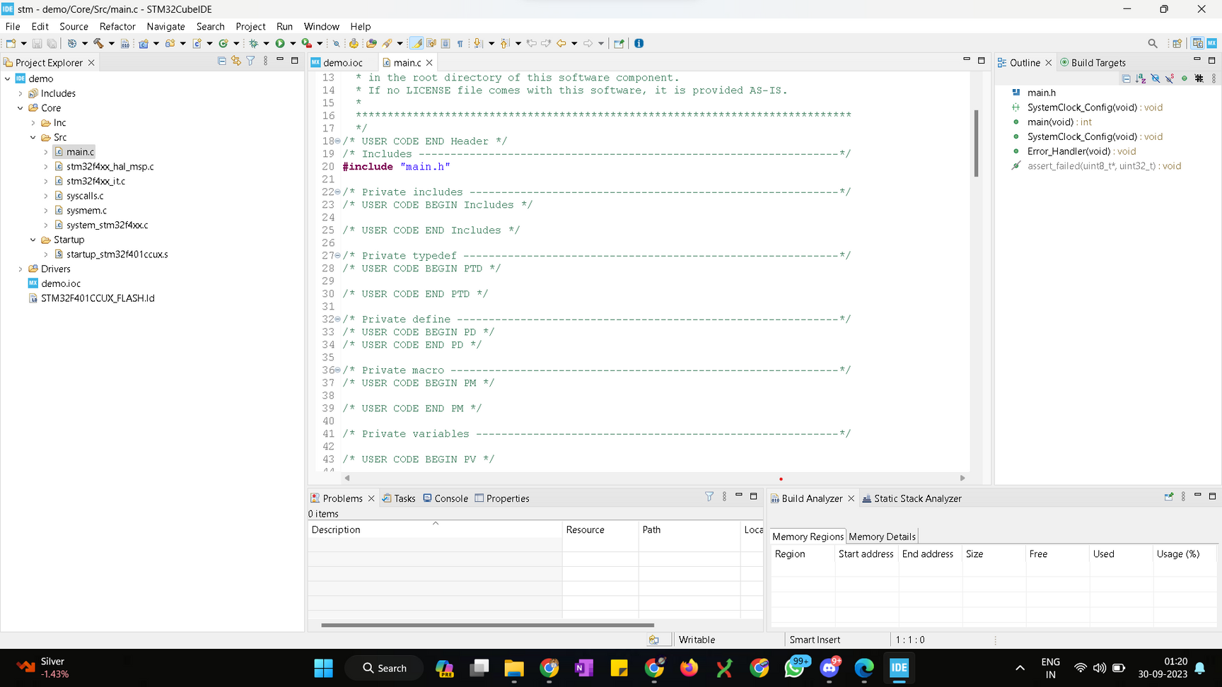
Step:- 9

Slide 21
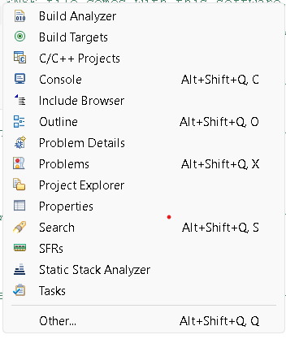
Step:- 10

Slide 22
Resources and Learning Materials
(Aman Kumar Singh)

Slide 23
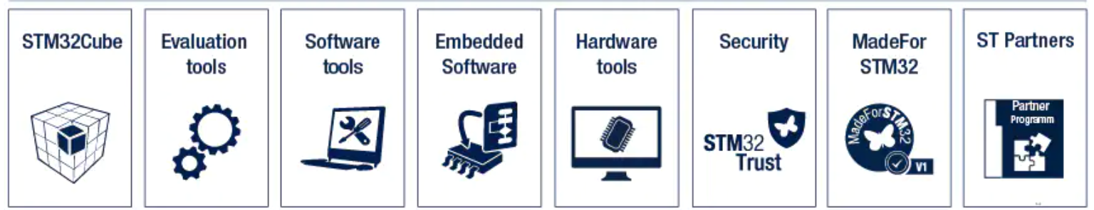
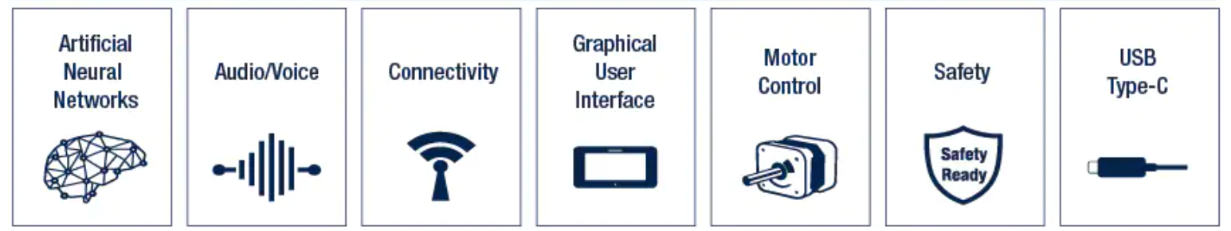
STM32 Ecosystem
STM32 Solutions

Slide 24
STM32 Learning / Communities

Slide 25
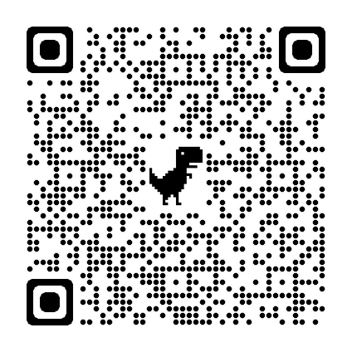
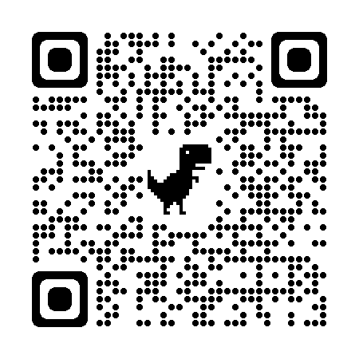
STM Official Resources
STM32 Education
STM32 Online Training
STM Community

Slide 26
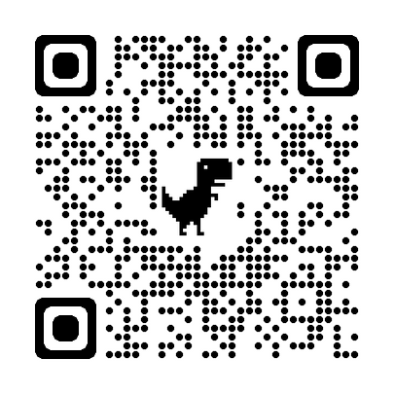
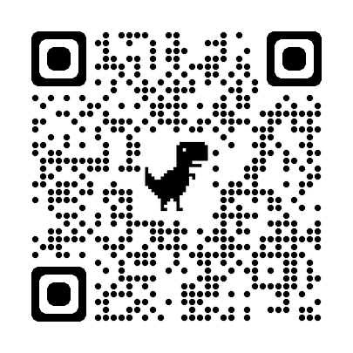
STM Learning Guide
STM32-base project
STM_GITHUB

Slide 27
Thank You !

Slide 28
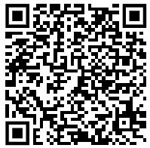
Link for Quiz

Slide 29
M2M
S.No. | Event | Timing
1 | Ignoration ceremony | 2:50PM - 3:00PM
2 | Start of the event | 3:00PM - 3:50PM
3 | Quiz | 3:50PM - 4:10
4 | Results announcement | 4:10PM - 4:20PM

